Slide 1
The filtered and Culled Visibility Buffer
Wolfgang Engel
Confetti
January 18th, 2017

Slide 2
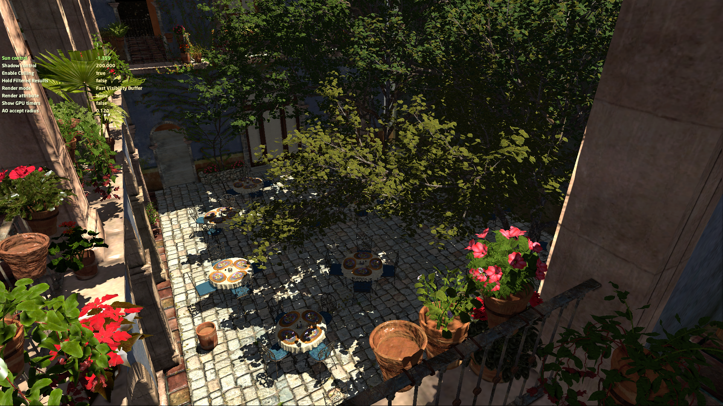
Demo

Slide 3
Source Code
https://we.tl/FdUwRTnxpE

Slide 4
Table of contents
The Visibility Buffer
Cluster Culling / Triangle Filtering
Re-using triangle filtered results for multiple rendering passes

Slide 5
The Visibility Buffer

Slide 6
Motivation
Forward rendering shades all fragments in triangle-submission order
Wastes rendering power on pixels that don’t contribute to the final image
Deferred shading solves this problem in 2 steps:
First, surface attributes are stored in screen buffers -> G-Buffer
Second, shading is computed for visible fragments only
However, deferred shading increases memory bandwidth consumption:
Screen buffers for: normal, depth, albedo, material ID,…
G-Buffer size becomes challenging at high resolutions

Slide 7
High-Level View 2009
G-Buffer (taken from [Engel2009] Killzone 2 layout)
Render opaque objects
Transparent objects
8:8:8:8
8:8:8:8
8:8:8:8
Normals
Specular / Motion Vec
Albedo / Shadow
Depth Buffer
32-bit
Deferred Lighting
Switch off depth write
Forward Rendering
Sort Back-To-Front

Slide 8
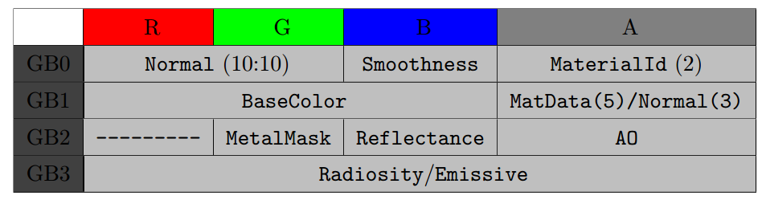
High-Level View 2014
G-Buffer – Frostbite Engine [Lagarde]
10:10:10:2
8:8:8:8
8:8:8:8
11:11:10
Depth - R32G8X24_TYPELESS

Slide 9
High-Level View 2014
G-Buffer – Frostbite Engine [Lagarde]
Render opaque objects
Transparent objects
10:10:10:2
8:8:8:8
8:8:8:8
Normals etc.
BaseColor etc.
MetalMask etc.
11:11:10
IBL / GI
Depth Buffer
32-bit
Deferred Lighting
Switch off depth write
Forward Rendering
Sort Back-To-Front

Slide 10
High-Level View
Visibility Buffer (similar to [Burns][Schied])
8:8:8:8
Encodes - 1 bit alpha-mask
- 8-bit drawID
- 23-bit triangleID / primID
Visibility
Depth Buffer
Vertex Buffer holds opaque and transparent objects
Vertex / Index Buffer
Transparent objects
Lighting
Sort Back-To-Front
Forward Rendering
Notes:
1-bit alpha is used to tell which buffer to look at:
There is one buffer with alpha masked geometry and one buffer with opaque geometry. Each one is drawn with a dedicated indirect command buffer.
8-bit drawID:
We use multiDrawIndirect (or ExecuteIndirect in DirectX 12) to draw all batches at once
drawID represents which of those draw batches the triangle belongs to
23-bit triangleID:
This describes the ith-triangle in a batch j
instanceID: depends on how we want to distribute between non-instanced and instanced

Slide 11
Visibility Buffer PC 1080p – Memory
Memory | Description | NoMSAA | 2xMSAA | 4xMSAA
Visibility Buffer | keeps address of each triangle in 32-bit per pixel 4 bytes * 1920 * 1080 | 7.9 MB | 15.8 MB | 31.6* MB
Depth Buffer | 4 byte * 1920 * 1080 | 7.9 MB | 15.8 MB | 31.6* MB
Hierarchical Z | 4 byte * 1920 * 1080 * 1/64 | 0.12 MB | - | -
Vertex Buffer | 28 bytes per vertex + padding float3 position; uint normal; uint tangent; uint texCoord; uint materialID; uint pad; // to align to 128 bits – 32 byte for NVIDIA Does not increase with resolution.
Textures |  | 21* MB | - | -
 | Draw arguments, Uniform, Descriptors etc. | 2* MB | - | -
Overall |  | 38.80* MB | 54.60* MB | 86.20* MB
* rough estimate; driver might increase it

Slide 12
G-Buffer PC 1080p – Memory
Memory | Description | NoMSAA | 2xMSAA | 4xMSAA
Normals | 10:10:10:2 - 4 bytes * 1920 * 1080 | 7.9 MB | 15.8* MB | 31.6* MB
PBR | 8:8:8:8 - 4 bytes * 1920 * 1080 | 7.9 MB | 15.8* MB | 31.6* MB
Albedo | 8:8:8:8 - 4 bytes * 1920 * 1080 | 7.9 MB | 15.8* MB | 31.6* MB
GI / IBL | 11:11:10 - 4 bytes * 1920 * 1080 | 7.9 MB | 15.8* MB | 31.6* MB
Depth | 8:8:8:8 - 4 bytes * 1920 * 1080 | 7.9 MB | 15.8* MB | 31.6* MB
Hierarchical Z | 4 bytes * 1920 * 1080 * 1/64 | 0.49 MB | - | -
Draw arguments. Etc. |  | 2* MB
Overall |  | 41.99* MB | 81.49* MB | 160.49* MB
* rough estimate; driver might increase it

Slide 13
Visibility Buffer PC 4k – Memory
Memory | Description | NoMSAA | 2xMSAA | 4xMSAA
Visibility Buffer | keeps address of each triangle in 32-bit per pixel 4 bytes * 3840 * 2160 | 31.64 MB | 63.28* MB | 126.56* MB
Depth Buffer | 4 bytes * 3840 * 2160 | 31.64 MB | 63.28* MB | 126.56* MB
Hierarchical Z | 4 bytes * 3840 * 2160 * 1/64 | 0.49 MB | - | -
Vertex Buffer | 28 bytes per vertex + padding float3 position; uint normal; uint tangent; uint texCoord; uint materialID; uint pad; // to align to 128 bits – 32 byte for NVIDIA Does not increase with resolution. |  | - | -
Textures |  | 21* MB
 | Draw arguments, Uniform, Descriptors etc. | 2* MB
Overall |  | 86.77 MB | 150.05 MB | 276.61 MB
* rough estimate; driver might increase it

Slide 14
G-Buffer PC 4k – Memory
Memory | Description | NoMSAA | 2xMSAA | 4xMSAA
Normals | 10:10:10:2 - 4 bytes * 3840 * 2160 | 31.64 MB | 63.28* MB | 126.56* MB
PBR | 8:8:8:8 - 4 bytes * 3840 * 2160 | 31.64 MB | 63.28* MB | 126.56* MB
Albedo | 8:8:8:8 - 4 bytes * 3840 * 2160 | 31.64 MB | 63.28* MB | 126.56* MB
GI / IBL | 11:11:10 - 4 bytes * 3840 * 2160 | 31.64 MB | 63.28* MB | 126.56* MB
Depth | 8:8:8:8 - 4 bytes * 3840 * 2160 | 31.64 MB | 63.28* MB | 126.56* MB
Hierarchical Z | 4 bytes * 3840 * 2160 * 1/64 | 0.49 MB | - | -
Draw arguments. Etc. |  | 2* MB | - | -
Overall |  | 160.69* MB | 318.89* MB | 635.29* MB
* rough estimate; driver might increase it

Slide 15
Visibility Buffer XOne 1080p – Memory
ESRAM | Description | NoMSAA | 2xMSAA
Visibility Buffer | keeps address of each triangle in 32-bit per pixel 4 bytes * 1920 * 1080 | 7.9 MB | 15.8 MB
Depth Buffer | 4 byte * 1920 * 1080 | 7.9 MB | 15.8 MB
Hierarchical Z | 4 byte * 1920 * 1080 * 1/64 | 0.12 MB | -
Notes:
Normals and tangents are packed Octahedral
An advantage of using a vertex centric struct rather than a triangle-centric struct is that we can use vertex indexing … the index buffer keeps the vertices unique like in indexed triangle lists … or indexed triangle lists …
Basically a vertex buffer mapped as a SRV
Material ID represents the texture set that is used. In PBR this would be a set of textures.
Texture2D textures[] : register(t7, space0); // new in SM5.1
Texture2D textures[512] : register(t7, space0); // XBOX One -> no unbounded array
Overall data read in worst case for shading scene is 31 MB … for textures and vertices … XBOX One 1080p

Slide 16
Visibility Buffer – Filling pseudocode
Visibility Buffer generation step
For each pixel on screen:
Pack (alpha masked bit, drawID, primitiveID) into 1 32-bit UINT
Write that into a screen-sized buffer
The tuple (alpha masked bit, drawID, primitiveID) will allow a shader to access the triangle data in the shading step
Notes:
We need drawID to later index into the command buffers …

Slide 17
Visibility Buffer – Shader code
// in visibilityPass.shd uint calculateOutputVBID(bool opaque, uint drawID, uint primitiveID){ uint drawID_primID = ((drawID << 23) & 0x7F800000) | (primitiveID & 0x007FFFFF); if (opaque) return drawID_primID; else return (1 << 31) | drawID_primID; }
float4 unpackUnorm4x8(uint p){ return float4(float(p & 0x000000FF) / 255.0, float((p & 0x0000FF00) >> 8) / 255.0, float((p & 0x00FF0000) >> 16) / 255.0, float((p & 0xFF000000) >> 24) / 255.0); }
cbuffer RootConstants : register(b0, space0){ uint DrawID; };
float4 main(uint primitiveID : SV_PrimitiveID) : SV_Target{ return unpackUnorm4x8(calculateOutputVBID(true,DrawID,primitiveID)); }

Slide 18
Visibility Buffer – Shading pseudocode
For each pixel in screen-space we do:
Get alpha mask bit/drawID/triangleID at pixel pos
Load data for the 3 vertices from the IB and then the VB
Compute the partial derivates of the barycentric coordinates – triangle gradients
Compute x and y value of each vertex of a triangle in projected screen-space
Compute partial derivatives
Interpolate vertex attributes at pixelpos using triangle gradient (could do triangle / object-space lighting)
Attribs use w from position to compute perspective correct interpolation
MVP matrix is applied to position
We have all data ready: shade and calculate final color
Notes:
We only have the w coordinate per vertex -> need it per pixel
Get partial derivatives of the barycentric coordinates
With partial derivatives and the delta vector reconstruct w at the pixel location with interpolation
Calculate z
Do the transform into world space of the position
Not using rasterizer

Slide 19
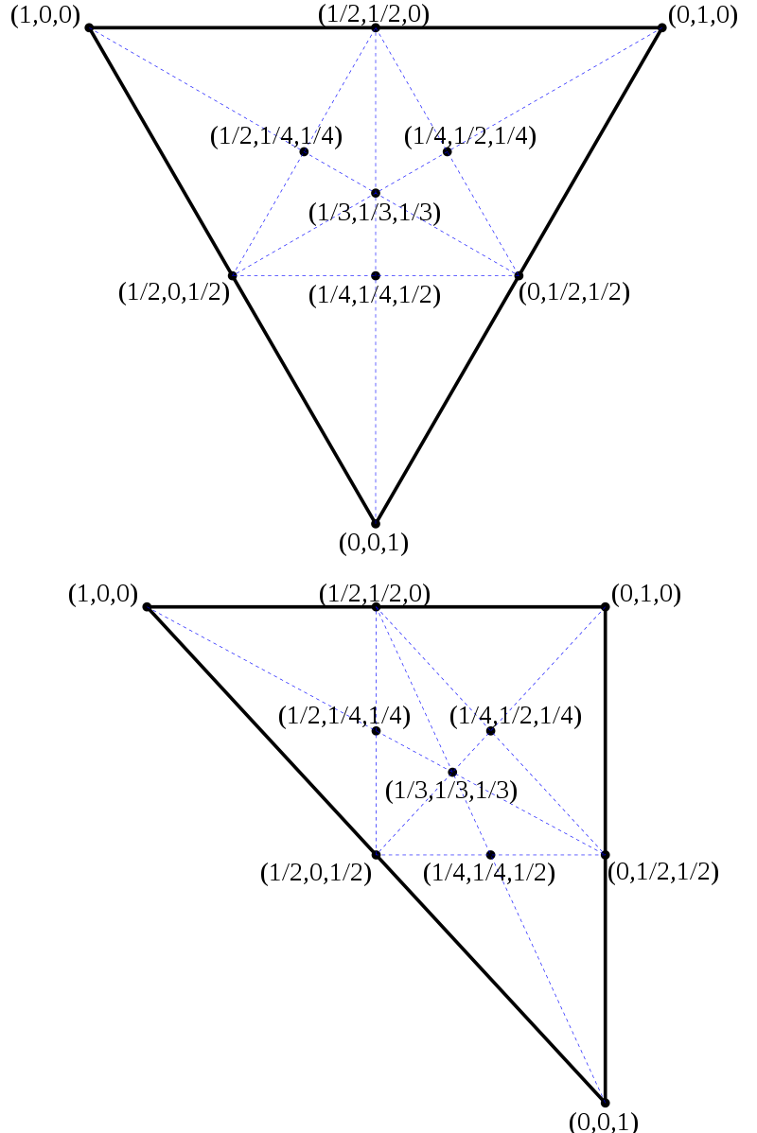
Visibility Buffer – Shading pseudocode
Barycentric coordinates λ₁, λ₂, λ₃ on an equilateral triangle and on a right triangle

Slide 20
Visibility Buffer – Shading pseudocode
Vertex 0
Point being shaded: we want to calculate vertex attributes at this position
Vertex 2
Vertex 1
Notes:
20

Slide 21
Visibility Buffer – Shading pseudocode
Vertex 0
We can divide the triangle like this. Splitting the triangle in 3 areas (A₀, A₁, and A₂)
A₂
A₁
A₀
Vertex 2
Vertex 1
Notes:
21

Slide 22
Visibility Buffer – Shading pseudocode
Vertex 0 (v0)
Then we can interpolate any vertex at pixel position (p) attribute using this formula:
attrAt(p) = (λ₀ * attrAt(v0) + λ₁ * attrAt(v1) + λ₂ * attrAt(v2)) / A
The barycentric coordinates are defined like this:
(A₀ / A, A₁ / A, A₂ / A) = (λ₀, λ₁, λ₂)
A₂
A₁
A₀
Vertex 2
(v2)
Vertex 1
(v1)
* A is the total triangle area * A₁ + A₂ + A₃ = A
Notes:
Lambda - λ
22

Slide 23
Visibility Buffer – Shading pseudocode
Then attribute interpolation is reformulated as this:
attrAt(p) = attr₀ + d_{x}* Σ attr_{i} * db_dx_{i} + d_{y} * Σ attr_{i} * db_dy_{i}
From barycentric coordinates we calculate the partial derivatives (because we need them to sample textures correctly):
db_dx = ∂λ_{i} / ∂x
db_dy = ∂λ_{i} / ∂y
Vertex 0 (v0)
d_{x}
d_{y}
d
Vertex 2
(v2)
Vertex 1
(v1)
* db_dx, db_dy and d are the variable names used in shader code in computePartialDerivatives()
Notes:
23

Slide 24

Visibility Buffer – Shading pseudocode
Following [Schied2015] Appendix A Equation (4):
/* void computePartialDerivatives(float2 v[3], out float3 db_dx, out float3 db_dy){ float d = 1.0 / determinant(float2x2(v[2] - v[1], v[0] - v[1])); db_dx = float3(v[1].y - v[2].y, v[2].y - v[0].y, v[0].y - v[1].y) * d; db_dy = float3(v[2].x - v[1].x, v[0].x - v[2].x, v[1].x - v[0].x) * d; }
*/ // in shadeSun.shd float3 one_over_w = 1.0 / float3(position0.w, position1.w, position2.w); // projected vertices float2 pos_scr[3] = {position0.xy *one_over_w.x, position1.xy *one_over_w.y, position2.xy *one_over_w.z }; float3 db_dx, db_dy; // gradient barycentric coords x/y computePartialDerivatives(pos_scr, db_dx, db_dy);

Slide 25
Visibility Buffer – Shading pseudocode
For each pixel in screen-space we do:
Get alpha mask bit/drawID/triangleID at pixel pos
Load data for the 3 vertices from the IB and then the VB
Compute the partial derivates of the barycentric coordinates – triangle gradients
Interpolate vertex attributes at pixelpos using the triangle gradient (could do triangle / object-space lighting)
Attribs use w from position to compute perspective correct interpolation
Inverse view projection matrix is applied to position
We have all data ready: shade and calculate final color
Notes:
Not using rasterizer? Advantage?

Slide 26
Visibility Buffer – Shading pseudocode
// in shadeSun.shd float3 db_dx, db_dy;
computePartialDerivatives(pos_scr, db_dx, db_dy);
// Calculate delta vector (d) that points from the projected vertex 0 to the current screen point
float2 d = In.screenPos + -pos_scr[0];
// Interpolate the 1/w (one_over_w) for all three vertices of the triangle
// using the partial derivatives and the delta vector
float w = 1.0 / interpolateAttribute(one_over_w, db_dx, db_dy, d);
// Reconstruct the Z value at this screen point performing only the necessary matrix * vector multiplication
// operations that involve computing Z
float z = w * projection[2][2] + projection[2][3];
// Calculate the world position coordinates:
// 1. projected coordinates at this point are In.screenPos and the computed z too
// 2. multiplying the perspective projected coordinates by the inverse view-projection matrix (invVP) produces world coordinates
float3 position = mul(invVP, float4(In.screenPos * w, z, w)).xyz;
Notes:
float interpolateAttribute(float3 attributes, float3 db_dx, float3 db_dy, float2 d)
{
float attribute_x = dot(attributes, db_dx);
float attribute_y = dot(attributes, db_dy);
float attribute_s = attributes[0];
return (attribute_s + d.x * attribute_x + d.y * attribute_y);
}

Slide 27
Visibility Buffer – Shading pseudocode
Compute w at pixel position using attribute interpolation.
Notes:
27

Slide 28
Visibility Buffer – Shading pseudocode
Compute w at pixel position using attribute interpolation.
Then we reconstruct z (depth at pixel position)
Using the projection matrix and w:
float z = w * projection[2][2] + projection[2][3];
Notes:
28

Slide 29
Visibility Buffer – Shading pseudocode
Compute w at pixel position using attribute interpolation.
Finally, compute world position at current pixel from Z and W and the inverse of the view-projection matrix:
float3 position = mul(invVP, float4(In.screenPos * w, z, w)).xyz;
Then we reconstruct z (depth at pixel position)
Using the projection matrix and w:
float z = w * projection[2][2] + projection[2][3];
Notes:
29

Slide 30
Visibility Buffer – Shading pseudocode
Light position in world space
Eye position in world space
World space normal
We use world position to calculate lighting in world space
Notes:
30

Slide 31
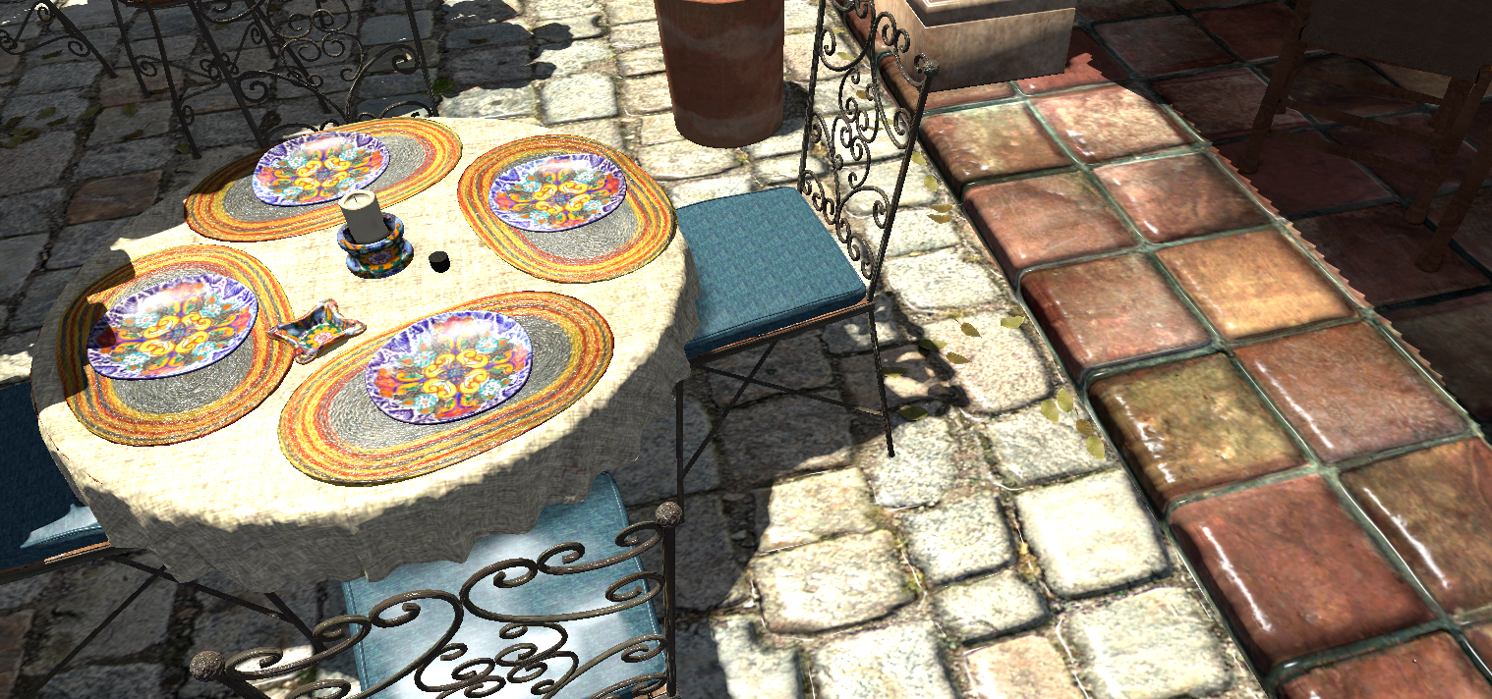
Visibility Buffer – Shading pseudocode
Triangle derivatives are also used to interpolate all triangle attributes:
- Position
- Texture coordinates
- Normal
- Tangent
Notes:
31

Slide 32
Visibility Buffer – Shading pseudocode
For each pixel in screen-space we do:
Get drawID/triangleID at pixel pos
Load data for the 3 vertices from the IB and then the VB
Compute the partial derivates of the barycentric coordinates – triangle gradidents
Interpolate vertex attributes at pixelpos using gradients (could do triangle / object-space lighting)
Attribs use w from position to compute perspective correct interpolation
Inverse view projection matrix is applied to position
We have all data ready: shade and calculate final color -> we skip the shading source code here … just Blinn-Phong
Notes:
Not using rasterizer? Advantage?

Slide 33
Visibility Buffer - Benefits
Better decouples visibility from shading
Calculating derivatives can be done separate from the shading phase (we include it in the moment)
We can shade then with different frequency or quality
Improves memory efficiency
Improves cache utilization
Memory accesses are highly coherent → high cache hit rates
A G-Buffer needs to store data per screen-space pixel. Compared to a vertex / index buffer some of this data is redundant -> we can see 99% L2 cache hits for the Visibility Buffer for textures, vertex and index buffers
Notes:
in the G-buffer you need to fetch all pixel data because it is significant
we added an indirection to that
so all pixels in a triangle hold the same value which points to a small region in the VB
Example: triangle that has one color

Slide 34
Visibility Buffer - Benefits
Stores less data for complex lighting models like e.g. PBR compared to a G-Buffer
PBR data for Visibility Buffer is a struct in constant memory indexed by material id in vertex buffer
This struct holds indices into a texture array for various PBR textures
It also holds per-material descriptions of what is necessary to drive BRDF
Any data that changes per-pixel is stored in textures that are referenced by the struct
Decouples G-buffer footprint from screen resolution
Improves performance at high resolutions: 2K, 4K, MSAA …
Improves performance on bandwidth-limited platforms
Notes:
Why does it store less data for PBR?
There is PBR data per material and per pixel.
The index in the Visibility Buffer is going into a constant memory struct. This struct holds indices for the various PBR textures and per material descriptions of what is necessary to drive BRDF. Any data that changes per pixel is stored in textures that are referenced in that struct.

Slide 35
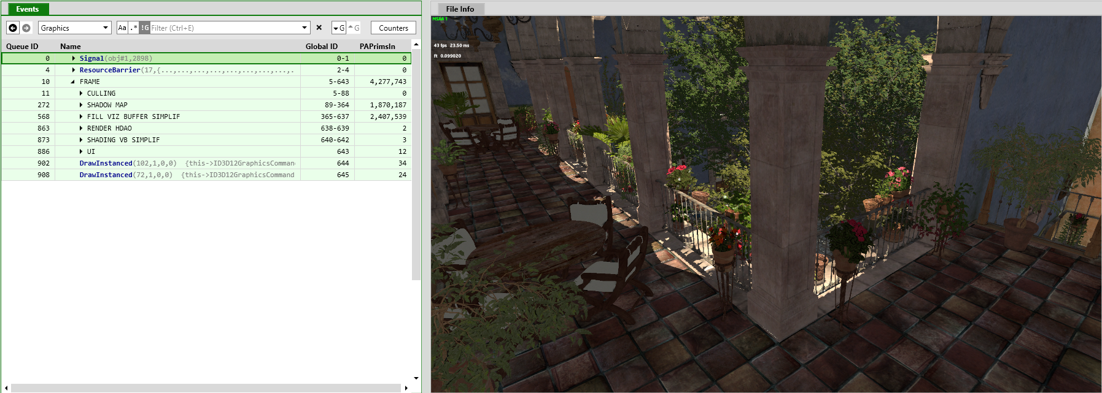
Visibility Buffer – Triangle Counts
San Miguel Scene
8 Million Triangles
5 Million Vertices
Triangles rendered after culling
1.87 Million triangles shadow map view
2.40 Million triangles main view
Modern Game in 2016
1.8 Million triangles combined in Ultra

Slide 36
How do you do lighting?
We calculate for each pixel the lighting based on the triangle data and therefore replace the whole rendering pipeline incl. the vertex shader, primitive assembly and (optionally rasterizer) in a compute / pixel shader
Because all the triangle data is available, Object-Space lighting should be possible -> the idea is that the whole triangle is lit in object-space and the result is cached

Slide 37
What about Tessellation?
Following [Wihlidal][Brainerd] this is a pre-step before or in parallel to Triangle filtering

Slide 38
Why didn’t we implement this earlier?
Two recent developments made the Visibility Buffer more attractive compared to a G-Buffer
DirectX 12 / Vulkan with ExecuteIndirect or multi draw indirect
Triangle culling / filtering [EDGE][Chajdas] [Wihlidal] … see the next slides …
Notes:
We have one extra level of indirection compared to deferred, in fact our approach needs bindless textures to work … that’s now available with DirectX 12 / Vulkan in generic way

Slide 39
Cluster Culling / Triangle filtering

Slide 40
Motivation
Polygonal complexity of games increases every year
Efficient triangle removal is an important aspect
2 culling stages
Cluster culling : cull groups of triangles before sending them to the GPU (following [Chajdas] on the CPU; [Wihlidal] on GPU)
Triangle Filtering: cull individual triangles in a compute shader
Notes:
Volume construction: I think he is just saying that, since the method we use is just an approximation of that paper, might not be able to obtain the optimal / mathematically correct solution the paper describes
however the worst case for the paper is O(n^3)
so the solution we are using (which is O( n ) always) might be better suited for real-time applications like games
----------------------
From Jesus
Hi Matthaeus, Thanks for pointing us to that paper, we think it might be worth implementing that, since producing more accurate cones could help the algorithm discard more geometry earlier (and more efficiently).
Anyway, I was considering implementing the cluster culling part on the GPU as well. That way we might be able to introduce more accurate tests at cluster culling time (fustrum culling / depth culling) that should allow to discard more geometry earlier. Also, I think it is necessary since we want to be able to feed the culling system with dynamically tessellated geometry...
What do you think?
Cheers.
----------------
From Mattaeus
Hi Jesus,
absolutely – doing a pass over the clusters on the GPU would allow per-cluster frustum, depth, and back-face culling, and is going to be beneficial going forward – more so than the fine-grained culling which can’t be made more efficient and which highly depends on the actual raster pipeline throughput.
Basically the whole thing needs to be two-phase, coarse and fine-grained culling, and GeometryFX does the fine-grained culling pretty well (except for depth cull, but fine-grained depth cull is borderline on efficiency because you have one texture fetch per triangle), while coarse-grained culling is very basic. Extending the coarse-grained culling is going to provide the most !/$ going forward.
Cheers,
Matthäus

Slide 41
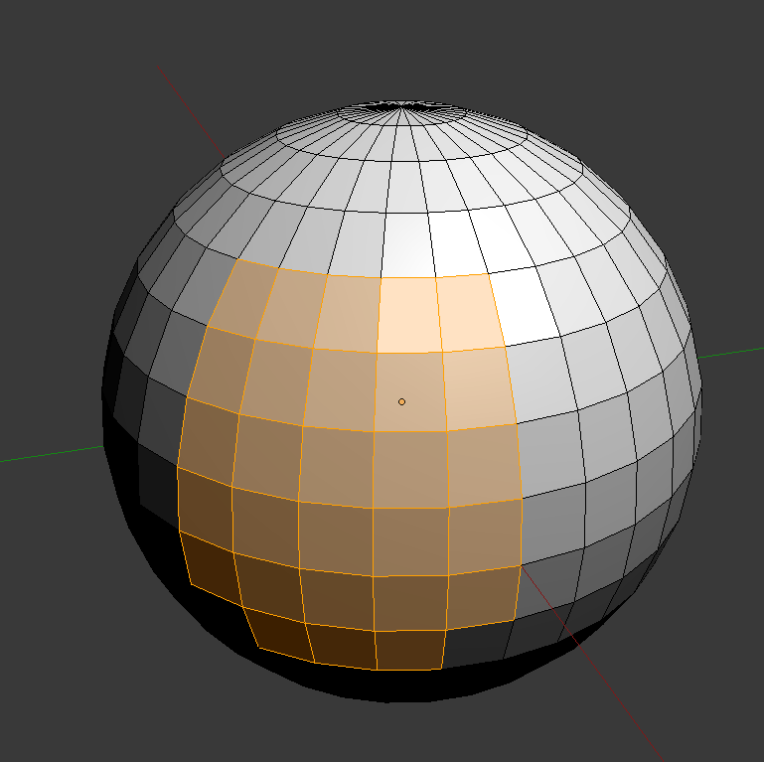
Cluster culling
Groups triangles in small chunks of 256 triangles with similar orientations
Chunks have a model matrix associated (they can be moved around)
Each chunk must pass a quick visibility test before being sent to the GPU:
Cone test
Notes:
We had a small performance benefit coming from triangle cluster culling at the beginning. When we extended triangle filtering to more than one view, we didn’t see any performance benefit anymore.
When we only cull clusters that can not be seen from several view points, the number of clusters becomes fairly low and it becomes less appealing.

Slide 42

Cone test for fast cluster culling
Normals
Triangle cluster
Triangles
If the eye is in the safe area then we can NOT see any triangle because they are back-facing
Exclusion volume

Slide 43
Exclusion volume
Normals
Triangles
First, locate the center of the cluster

Slide 44
Exclusion volume
Normals
Then, negatively accumulate normal starting at cluster center

Slide 45
Exclusion volume
Normals
Negatively accumulate second normal after the first one

Slide 46
Exclusion volume
Normals
Accumulate next one

Slide 47
Exclusion volume
Normals
After accumulating the last one we have the starting point of the exclusion volume and the direction

Slide 48
Exclusion volume
Most restrictive triangle
planes used to calculate cone open angle
Cone angle
This is the calculated exclusion volume
If the eye is in this area then the eye can NOT see any triangle

Slide 49
Cluster Culling
Effectivity depends on the orientation of the faces in the cluster
The more similar the orientations, the bigger the exclusion / culling volume
Depending on the triangles the exclusion volume can not be calculated
Invalid cluster for cluster culling → just pass it!
Invalid cluster → cluster culling not possible

Slide 50
Cluster Culling
Code can be found in TriangleFiltering.h
RegisterGeometryForTrianglefiltering() // adds all buffers necessary for triangle filtering later and creates triangle clusters
TriangleClusterCulling() // actual triangle cluster culling

Slide 51
Compute-based triangle filtering
Motivation:
Filter triangles before they go into the graphics pipeline
Use the unused compute units during graphics pipeline execution with async compute
Compute-based filter → one triangle per thread
Degenerate triangle culling
Back-face culling
Frustum culling
Small primitives culling
Depth culling (requires coarse depth buffer)(not in this demo)
Triangle indices that pass these tests are appended to index buffer

Slide 52
Compute-based triangle filtering
Degenerate triangle culling
Allows to cull invisible zero-area triangles
Cost:→ quick test (discard if at least two triangle indices are equal)
Effectiveness:→ low
// in filterTriangles.shd #if ENABLE_CULL_INDEX
if ( indices[0] == indices[1]
|| indices[1] == indices[2]
|| indices[0] == indices[2])
{
cull = true;
}
#endif

Slide 53
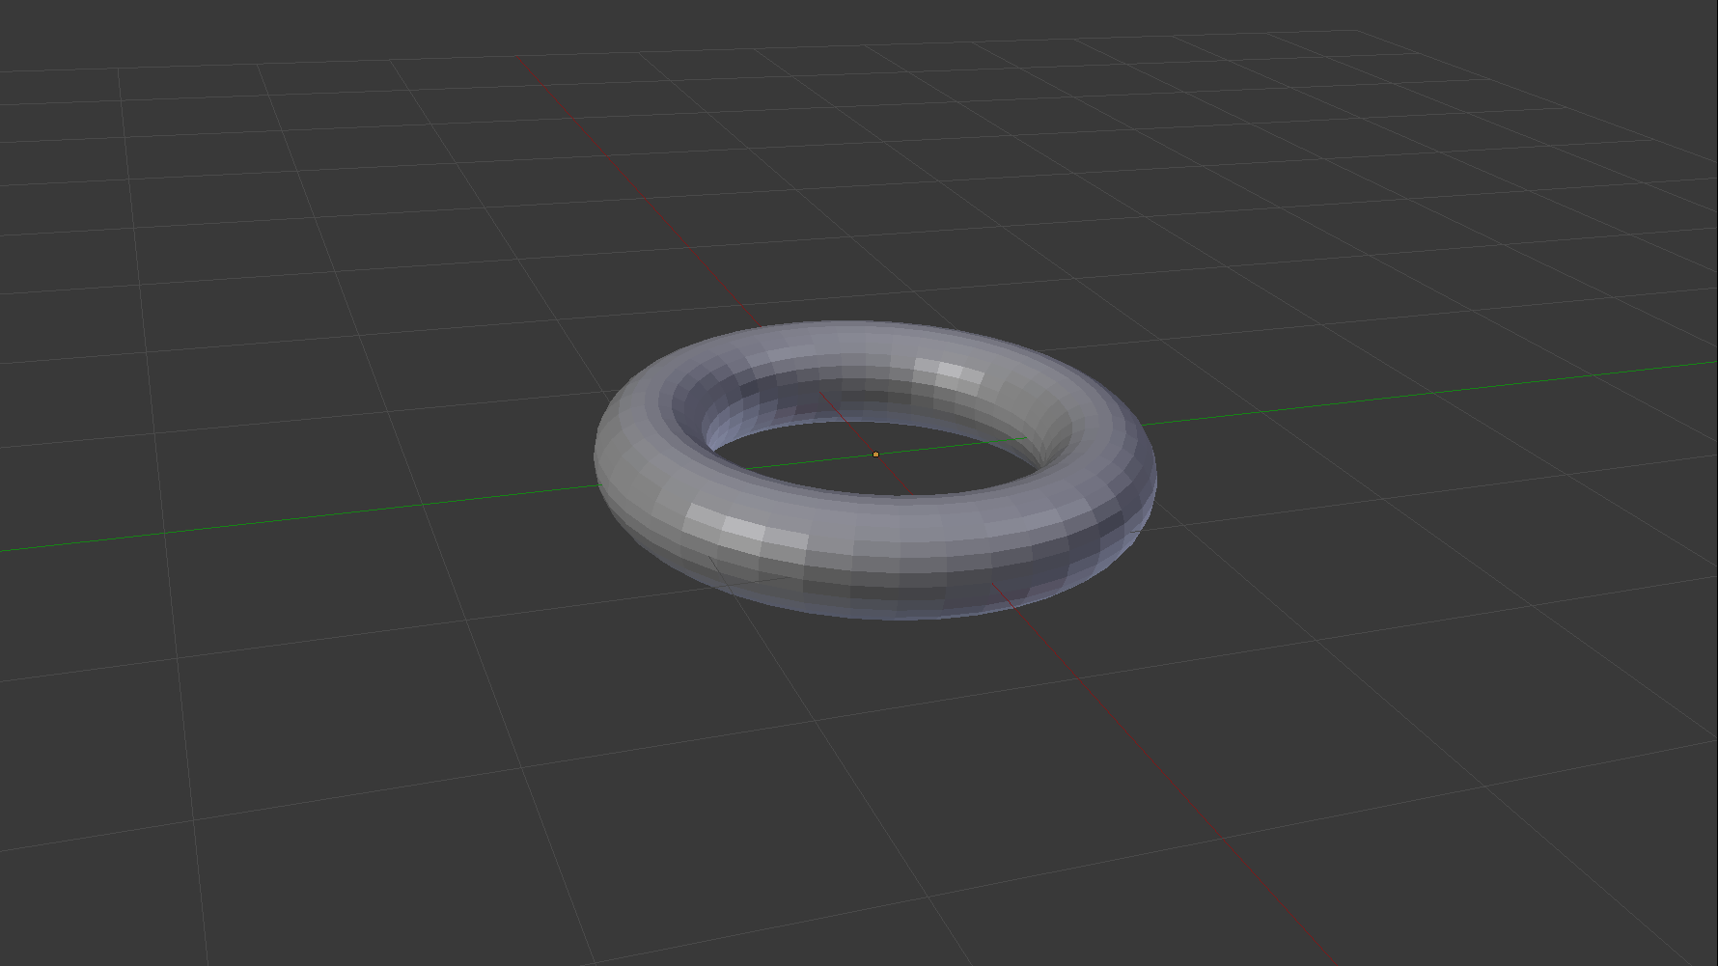
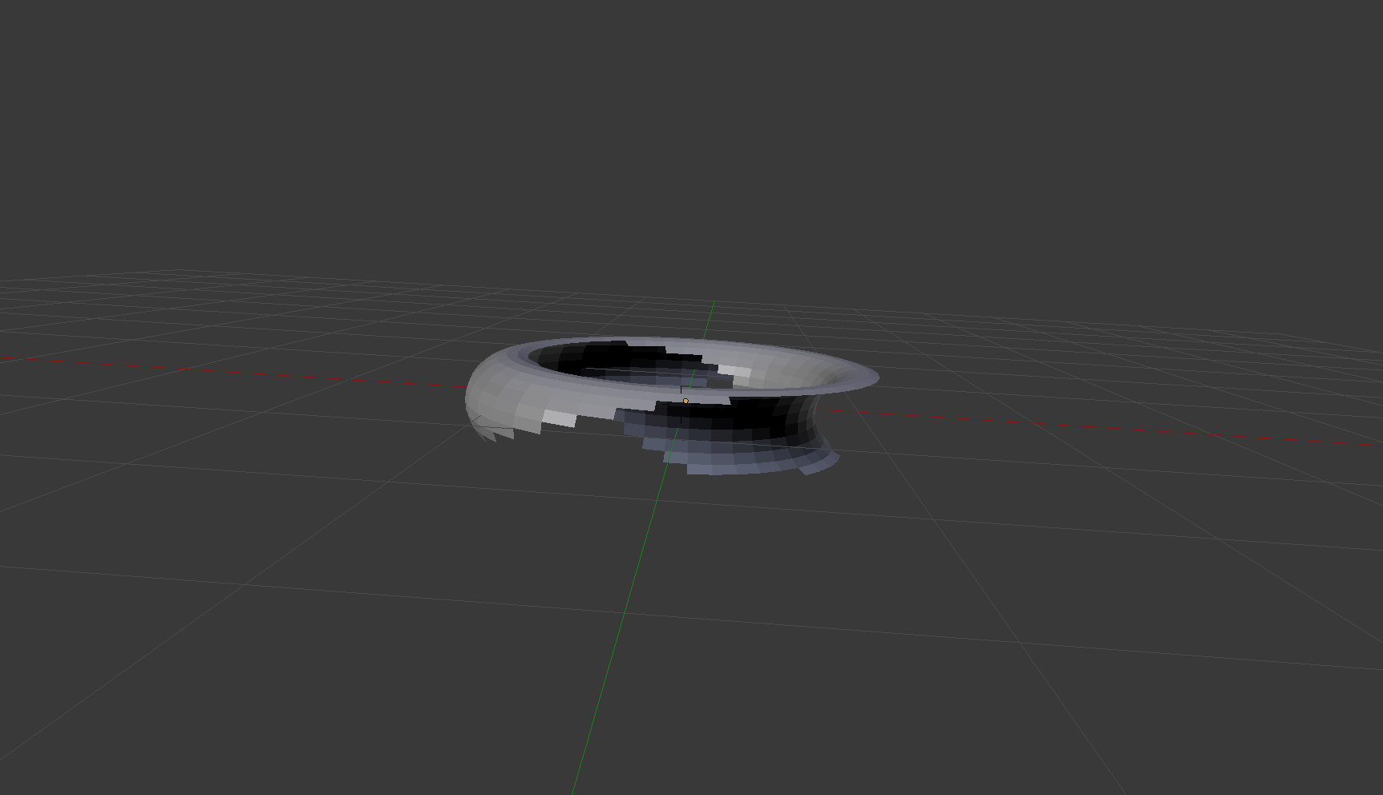
Compute-based triangle filtering
Back-face culling
Allows to cull triangles that face away from the viewer
If tessellation is used must take into account max patch height
Cost:→ calculate the determinant of a 3x3 matrix [Olano] (homogeneous 2D coordinates) determinant > 0 -> has no inverse -> back-facing -> shouldn’t be rendered
Effectiveness:→ high (potentially cull 50% of the geometry)

Slide 54
Compute-based triangle filtering
Build 3x3 matrix of homogenous coordinates of the vertices
If this matrix doesn’t have an inverse, it is back-facing -> should not be rendered
// in filterTriangles.shd #if ENABLE_CULL_BACKFACE
// Culling in homogenous coordinates
// Read: "Triangle Scan Conversion using 2D Homogeneous Coordinates"
// by Marc Olano, Trey Greer
// http://www.cs.unc.edu/~olano/papers/2dh-tri/2dh-tri.pdf
float3x3 m = float3x3(vertices[0].xyw, vertices[1].xyw, vertices[2].xyw);
if (cullBackFace)
cull = cull || (determinant(m) > 0);
#endif
Notes:
It is in section 5.2 of this paper: it states that if the matrix composed of the homogenous coordinates of the vertices has no inverse, then it shouldn't be rendered because it's back-facing
to see if it has inverse or not, you check the determinant
In which space is vertices[]? In eye space

Slide 55
Compute-based triangle filtering
Near Plane clipping -> triangles behind the near clipping plane of the frustum -> need to be clipped
// in filterTriangles.shd #if ENABLE_CULL_FRUSTUM || ENABLE_CULL_SMALL_PRIMITIVES
int verticesInFrontOfNearPlane = 0;
// Transform vertices[i].xy into normalized 0..1 screen space
for (uint i = 0; i < 3; ++i) {
if (vertices[i].w < 0) { // check for behind near clipping plane
++verticesInFrontOfNearPlane;
// flip the w so that any triangle that stradles the plane won’t be projected onto
// two sides of the frustrum
vertices[i].w *= (-1.f);
}
vertices[i].xy /= vertices[i].w * 2;
vertices[i].xy += float2(0.5, 0.5);
}
#endif

Slide 56
Compute-based triangle filtering
Part 2 source code – triangle behind near clipping plane
// in filterTriangles.shd if (verticesInFrontOfNearPlane == 3)
{
cull = true;
}

Slide 57
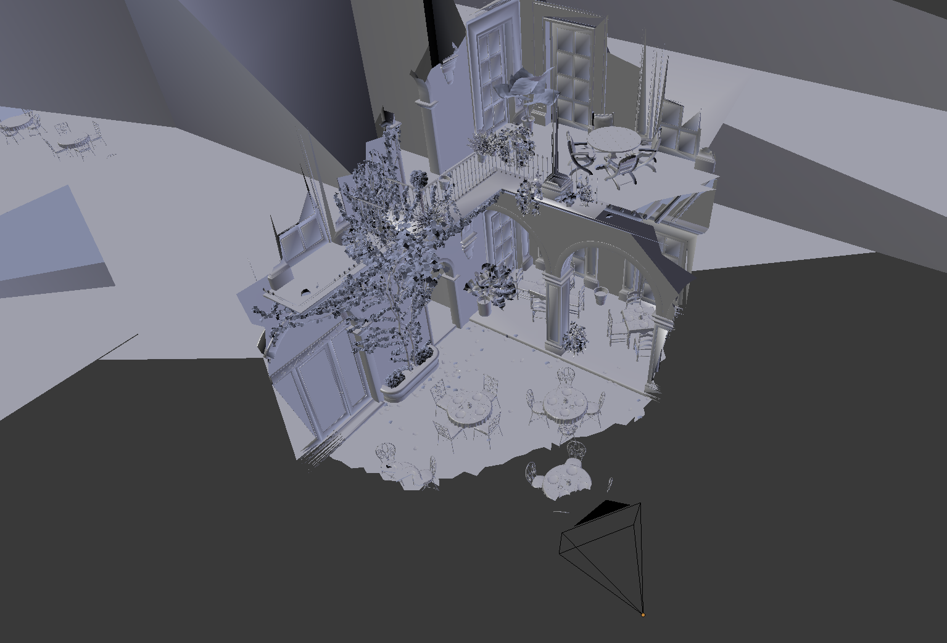
Compute-based triangle filtering
Frustum culling
Allows to cull triangles that are projected outside the clipping cube
Takes into account near and far planes
Cost:→ check if all vertices lie in the negative side of the clip-space cube
Effectiveness:→ medium-high (depends on the size of the scene and eye pos)

Slide 58
Compute-based triangle filtering
// in filterTriangles.shd
// normalized 0..1 range
// vertices[i].xy /= vertices[i].w * 2;
// vertices[i].xy += float2(0.5, 0.5);
#if ENABLE_CULL_FRUSTUM
{
if (verticesInFrontOfNearPlane == 3)
{
cull = true;
}
float minx = min (min (vertices[0].x, vertices[1].x), vertices[2].x);
float miny = min (min (vertices[0].y, vertices[1].y), vertices[2].y);
float maxx = max (max (vertices[0].x, vertices[1].x), vertices[2].x);
float maxy = max (max (vertices[0].y, vertices[1].y), vertices[2].y);
cull = cull || (maxx < 0) || (maxy < 0) || (minx > 1) || (miny > 1);
}
#endif
Notes:
// normalize 0..1 range
vertices[i].xy /= vertices[i].w * 2;
vertices[i].xy += float2(0.5, 0.5);

Slide 59
Compute-based triangle filtering
Small-primitives culling
Allows to cull triangles that are too small to be seen
Triangles that do not touch any sample point after projection
Long and thin triangles that do not touch any sample are culled as well
More efficient use of hardware resources
Cost:→ triangle touches any subpixel samples
Effectiveness:→ medium (depends on the size of the triangles and screen res)
Primitive-rate bound
only one primitive per cycle per tile can be scanned (see [Wihlidal])
Very inefficient use of rasterization units

Slide 60
Compute-based triangle filtering
Implementation is a two-step approach
Test if one of the vertices is outside the Guardband -> can’t be a small triangle
If all vertices of a triangle are inside the Guardband -> do the actual small size test

Slide 61
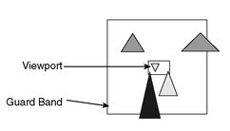
Compute-based triangle filtering
Guard band clipping Usually part of rasterization: there is a guard band around the viewport
Medium gray triangles -> outside viewport -> rejected
Light gray triangles -> completely in the guard band -> rasterized and the pixels outside of the viewport are ignored by rasterizer
Dark triangle needs to be clipped

Slide 62
Compute-based triangle filtering
Test if vertex outside the Guardband
// in filterTriangles.shd
int2 minBB = int2(1 << 30, 1 << 30);
int2 maxBB = int2(-(1 << 30), -(1 << 30));
bool insideGuardBand = true;
for (uint i = 0; i < 3; ++i) {
float2 screenSpacePositionFP = vertices[i].xy * windowSize;
// Check if we would overflow after conversion
if (screenSpacePositionFP.x < -(1 << 23)
|| screenSpacePositionFP.x > (1 << 23)
|| screenSpacePositionFP.y < -(1 << 23)
|| screenSpacePositionFP.y > (1 << 23)) { insideGuardBand = false;
}
// scale based on distance to from center to msaa sample point
int2 screenSpacePosition = int2(screenSpacePositionFP * (SUBPIXEL_SAMPLES * samples));
minBB = min (screenSpacePosition, minBB);
maxBB = max (screenSpacePosition, maxBB);
}
Notes:
minBB / maxBB is the bounding box of the triangle it is scaled by the number of samples in size … so the bounding box of the triangle is bigger
We are testing to see if the bounding box of the triangle contains any samples.
Floating point wastes a lot of precision with its distribution so we use a fixed point representation that has a uniform distribution so we don't run into an issue with we subtract two numbers and get a precision error. Compiler might cast the fixed point number to fp.
The guard band is a way of detecting if we are going to overflow when we go to the 23.8 fixed point. If we overflow then we will skip culling it because it is either outside the view frustum or it is a really big triangle.
screenSpacePositionFP is in 0..1 range
SUBPIXEL_SAMPLES converts the number to the fixed-point representation. samples is the scaling factor for MSAA. which conveniently for 2x, 4x and 8x is the number of samples per pixel.
My idea for MSAA is that we scale by the positions by the distance of the farthest sample from the center so that 1 unit will occupy one pixel position. it will have false positives since it does not consider the layout of the samples. No idea if it would be worth it to add in the default sample patterns to the filtering. Might be something interesting to try.

Slide 63
Compute-based triangle filtering
Is the triangle of “small” size?
// in filterTriangles.shd
if (insideGuardBand)
{
const uint SUBPIXEL_SAMPLE_CENTER = SUBPIXEL_SAMPLES / 2;
const uint SUBPIXEL_SAMPLE_SIZE = SUBPIXEL_SAMPLES - 1;
/*
Test is:
Is the minimum of the bounding box right or above the sample
point and is the width less than the pixel width in samples in
one direction.
This will also cull very long triangles which fall between
multiple samples.
*/
cull = cull || any( ((minBB & SUBPIXEL_MASK) > SUBPIXEL_SAMPLE_CENTER)
&& ((maxBB - ((minBB & ~SUBPIXEL_MASK) + SUBPIXEL_SAMPLE_CENTER)) < (SUBPIXEL_SAMPLE_SIZE)));
}
Notes:
// Is the triangle bounding box right or above the sample point -> this is the scaled up bounding box scaled by the number of samples …
(minBB & SUBPIXEL_MASK) > SUBPIXEL_SAMPLE_CENTER)
// Is the width of the triangle bounding box less than the pixel width in samples in one direction
// checks if it is thinner than a pixel
((maxBB - ((minBB & ~SUBPIXEL_MASK) + SUBPIXEL_SAMPLE_CENTER)) < (SUBPIXEL_SAMPLE_SIZE)));

Slide 64
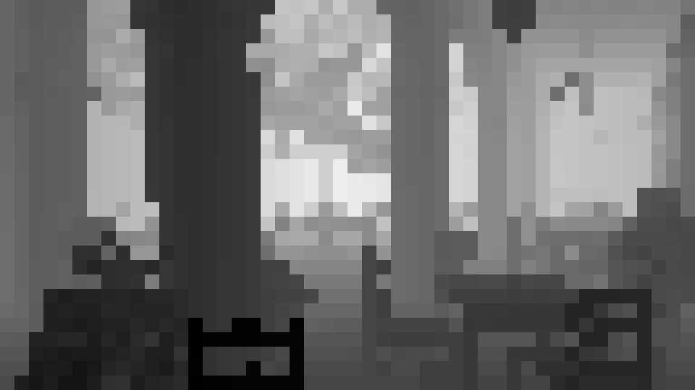
Compute-based triangle filtering
Depth culling (not used in this demo)
Allows to cull triangles that are occluded by the scene
This test requires a coarse depth buffer
Cost:→ load depth values from map and check triangle/BB intersection
Effectiveness:→ medium-high (depends on scene complexity and the size of the triangles)
Can be generated by
Downsampling previous z-buffer and reprojecting depths
Rendering selected LOD geometry at low res
Notes:
One of the main questions here is: do we do depth culling against
Triangles
Triangle cluster
Or something else?
mattheaus gave me a good response regarding depth culling on the GPU yesterday
he said doing the depth test at triangle level would be a little overkill since we would have to sample the texture for every triangle
he said it was better to do depth culling to discard the whole cluster
that makes sense
however, what I understood from Graham slides is they did depth-culling per triangle
since they classified depth culling in the same level of the other triangle tests
moreover, he showed images where the character seemed to be depth-culled at triangle level

Slide 65
Compute-based triangle filtering
Triangle filtering is executed on groups of 256 triangles (one batch) -> empty draws
Draw batch compaction to the rescue
Can be run in parallel in a compute shader
Eliminates empty draws from the indirect argument buffer
Degenerated triangles
Backfaces
Culling tests
Culled results
Compaction
Frustum
Small primitives
Depth
Draw this using multi draw indirect / ExecuteIndirect
Notes:
tringles in batches are always compacted, since the compute shader appends unculled triangles one after the other inside a batch
that's ok
in fact after culling maybe none of those batches have 256 triangles
because some were culled
each batch is associated with the number of triangles in a batch and the starting index in the index buffer
so for example:
batch1 --> start index:0 num indices:12
batch2: --> start index:12 num indices: 256 (this is full)
batch3 --> start index: 268 num indices: 120
Compaction is done in a CS …

Slide 66
Compute-based triangle filtering - Frame pseudocode
[CPU] Early discard invisible geometry using triangle cluster culling
[CS] Generate unculled indices and multi draw indirect buffers using triangle filtering (one triangle per thread)
Like before

Slide 67
Triangle cluster culling / filtering – Draw Calls
For this static scene one large vertex buffer and an index buffer generated by triangle culling and filtering is used
Draw batches that hold a block of geometry each for one material -> Only two “materials” opaque and alpha masked, transparent objects and other materials would go into the same buffer
For dynamic objects we would use a dedicated VB/IB pair for each; this is optional
Notes:
in our scene we have 5M vertices (VB) and 21M indices (IB)
however, we don't need to fully duplicate the IB if we do not want to draw it all at once
yes, each vertex is 24 bytes (including position and compressed texcoords, tangent and normal)
VB – 5 million vertices - 114 MB
IB – 21 million indices – 80 MB with 32-bit integers; we use 16-bit integers since draw batches are limited to 256 triangles
we also have the draw arguments buffer for the multidraw indirect
but that's small
that buffer contain batch definitions in gpu memory
it's only 5 uints per batch

Slide 68
Triangle cluster culling / filtering – Draw Calls
ExecuteIndirect makes it possible to completely defer the workload to the GPU, so that the actual work items can be batched in a more coherent way
Grouping multiple draw calls into a single one
reduces CPU overhead -> only a single Graphics API call
reduces GPU overhead (alleviates pressure on VS, CP and triangle assembly) by letting the user provide an optimal set of workload through
culling indices == invisible triangles through async compute
culling draw calls -> the resulting indirect argument buffer only includes valid draw calls
See more next slide deck “Execute Indirect”
Notes:
ExecuteIndirect replaces / enhances DrawIndirect and DispatchIndirect
Might require Material Layer Merging: a single ExecuteIndirect for each set of shader combinations to reduce state switching without breaking batching
Might allow Render Group Proxies: collection of nearby meshes can be drawn as a batch … shown in the Visibility Buffer demo
Other potential use cases:
GPU skinning with async compute
Tiled-based lighting
GPU sorting
GPU Particles

Slide 69
Triangle cluster culling / filtering – Draw Calls
San Miguel Scene Number of Draw calls (ExecuteIndirect)
Shadow opaque 214
Shadow alpha masked 59
Main view opaque 200
Main view alpha masked 60
Dispatch calls for filtering 81

Slide 70
Triangle cluster culling / filtering – Benefits
Allows to cull triangles before sending them to the graphics pipeline
Avoid overwhelming parts of the graphics pipeline (rasterizer)
Graphics pipeline is better utilized with the visible triangles (rasterizer efficiency, command processor,…)
Can make use of async compute to potentially overlap with the graphics pipeline

Slide 71
Re-using triangle filtered results for multiple Views / Rendering Passes

Slide 72
Motivation
Compute-based triangle filtering comes at a cost
For every triangle:→ load indices and vertices, transform vertices, append (lock) triangle data to index buffer
We came up with the idea to generate filtered data for several rendering passes like main view, shadows etc.
Use filtered data to cull the same triangle set from different views
Load indices/vertices, transform vertices only once for all views

Slide 73
Motivation
Reduces the effectiveness of cluster culling / triangle filtering
Harder to cull cluster for N views
However, overall we see huge speed-ups from multi-view triangle culling / filtering

Slide 74
Cull and filter Triangles for N-views
The algorithm is generalized to test against different N-views
Load indices / vertices once, transform vertices for every view
Algorithm
CPU
unculledClusters ← ClusterCulling(sceneObjs, views)
GPU
Compute
filteredIndicesArray ← TriangleCulling(unculledClusters, views)
GPU
Graphics
ShadowPass( filteredIndices[shadowView] )
GPU
Graphics
MainPass1( filteredIndices[mainView] )
GPU
Graphics
MainPass2( filteredIndices[mainView] )

Slide 75
Cull and filter Triangles for N-views - Frame pseudocode
[CPU] Early discard geometry not visible from any view using cluster culling
[CS] Generate N index and N multi draw indirect / ExecuteIndirect buffers by culling and filtering triangles against the N views (one triangle per thread)
For each i view use (ith index buffer and ith ExecuteIndirect buffer):
[Gfx] Clear visibility and depth buffers
[VS,PS] Visibility buffer pass
[PS] Output triangle / instance IDs
[PS] Interpolate attributes from gradients and shade pixel
* Using a dedicated Visibility Buffer for shadow pass is overkill, but you can still use the filtered data for it.

Slide 76

Results
San Miguel Scene average for main view
8 Million triangles
5 Million vertices
Total triangles | Rendered | Culled
8,010,146 | 851,517 (10.6%) | 7,158,629 (89.4%) | 3,185,203 (39.8%) | Back-face
 |  |  | 5,244,787 (65.5%) | Frustum
 |  |  | 1,950,030 (24.4%) | Small primitives
Notes:
one triangle may be culled in different tests

Slide 77
Visibility Buffer 3840 x2160
GPU | Culling | Shadow Map | Fill VB | HDAO | Shade VB | Resolve MSAA | UI | Overall
 | Visibility Buffer 4k – No MSAA
AMD RADEON R9 380 | 2.66 | 1.42 | 5.07 | 2.51 | 3.43 | - | 0.02 | 15.19
NVIDIA GeForce GTX 970 | 3.46 | 1.12 | 3.36 | 1.82 | 3.29 | - | 0.02 | 13.52
 | Visibility Buffer 4k – No MSAA No Culling
AMD RADEON R9 380 | - | 5.18 | 9.25 | 2.51 | 3.43 | - | 0.02 | 20.45
NVIDIA GeForce GTX 970 | - | 3.74 | 5.31 | 1.79 | 3.25 | - | 0.02 | 14.39
 | Visibility Buffer 4k – 2x MSAA
AMD RADEON R9 380 | 2.72 | 1.42 | 8.27 | 3.65 | 8.27 | 2.29 | 0.03 | 25.87
NVIDIA GeForce GTX 970 | 3.34 | 1.09 | 6.17 | 3.58 | 6.17 | 0.34 | 0.02 | 19.87
 | Visibility Buffer 4k – 4x MSAA
AMD RADEON R9 380 | 2.70 | 1.43 | 8.73 | 5.70 | 15.58 | 3.61 | 0.03 | 37.86
NVIDIA GeForce GTX 970 | 3.37 | 1.11 | 7.86 | 6.86 | 12.35 | 0.87 | 0.02 | 32.68

Slide 78
Deferred Shading 3840 x2160
GPU | Culling | Shadow Map | Fill Buffer | HDAO | Shade Buffer | Resolve MSAA | UI | Overall
 | Deferred Shading 4k – No MSAA
AMD RADEON R9 380 | 2.67 | 1.42 | 12.19 | 2.51 | 1.29 | - | 0.03 | 20.19
NVIDIA GeForce GTX 970 | 3.36 | 1.20 | 9.04 | 1.79 | 1.21 | - | 0.02 | 16.82
 | Deferred Shading 4k – No MSAA No Culling
AMD RADEON R9 380 | - | 5.18 | 15.00 | 2.51 | 1.29 | - | 0.03 | 24.06
NVIDIA GeForce GTX 970 | - | 3.75 | 10.44 | 1.79 | 1.22 | - | 0.02 | 17.49
 | Deferred Shading 4k – 2x MSAA
AMD RADEON R9 380 | 2.70 | 1.42 | 21.65 | 3.65 | 10.86 | 2.29 | 0.03 | 42.68
NVIDIA GeForce GTX 970 | 3.35 | 1.10 | 15.36 | 3.59 | 2.41 | 0.34 | 0.02 | 26.27
 | Deferred Shading 4k – 4x MSAA
AMD RADEON R9 380 | 2.72 | 1.44 | 35.88 | 5.74 | 20.13 | 3.60 | 0.02 | 69.64
NVIDIA GeForce GTX 970 | 3.40 | 1.18 | 30.29 | 6.87 | 5.39 | 0.87 | 0.02 | 48.12

Slide 79
XBOX One - Visibility Buffer 1080p
GPU | Culling | Shadow Map | Fill VB | HDAO | Shade VB | Resolve MSAA | UI | Overall
 | Visibility Buffer 1080p – No MSAA
Xbox One | 7.19 | 3.32 | 3.90 | 1.73 | 3.90 | - | 0.02 | 19.78
 | Visibility Buffer 1080p – No MSAA No Culling
Xbox One | - | 9.16 | 9.09 | 1.73 | 3.89 | - | 0.02 | 23.98
 | Visibility Buffer 1080p – 2x MSAA
Xbox One | 7.28 | 3.20 | 7.57 | 5.17 | 7.57 | 0.46 | 0.02 | 28.00

Slide 80
XBOX One - Deferred Shading 1080p
GPU | Culling | Shadow Map | Fill Buffer | HDAO | Shade Buffer | Resolve MSAA | UI | Overall
 | Deferred Shading 1080p – No MSAA
Xbox One | 7.19 | 3.14 | 11.18 | 1.74 | 1.38 | - | 0.02 | 24.77
 | Deferred Shading 1080p – No MSAA No Culling
Xbox One | - | 9.09 | 15.07 | 1.73 | 1.39 | - | 0.02 | 27.45
 | Deferred Shading 1080p – 2x MSAA
Xbox One | 7.21 | 3.18 | 21.85 | 5.18 | 8.46 | 0.47 | 0.02 | 46.41

Slide 81
Summary
Deferred Shading
Visibility Buffer
GPU AMD RADEON R9 380 | 1080p | 1440p | 2160p
No MSAA | 9.75 | 12.30 | 20.19
No MSAA – No Culling | 14.16 | 16.66 | 24.06
2x MSAA | 16.16 | 23.09 | 42.68
4x MSAA | 24.90 | 36.37 | 69.64
GPU AMD RADEON R9 380 | 1080p | 1440p | 2160p
No MSAA | 8.57 | 10.72 | 15.19
No MSAA – No Culling | 14.52 | 15.86 | 20.45
2x MSAA | 11.44 | 16.38 | 25.87
4x MSAA | 15.27 | 20.82 | 37.86
NVIDIA GeForce GTX 970 | 1080p | 1440p | 2160p
No MSAA | 8.72 | 10.67 | 16.82
No MSAA – No Culling | 10.30 | 11.91 | 17.49
2x MSAA | 11.58 | 15.23 | 26.27
4x MSAA | 17.00 | 24.76 | 48.12
NVIDIA GeForce GTX 970 | 1080p | 1440p | 2160p
No MSAA | 7.68 | 8.83 | 13.52
No MSAA – No Culling | 9.44 | 10.64 | 14.39
2x MSAA | 9.63 | 12.21 | 19.87
4x MSAA | 12.47 | 17.47 | 32.68
Xbox One | 1080p | 1440p | 2160p
No MSAA | 24.77 | - | -
No MSAA – No Culling | 27.45 | - | -
2x MSAA | 46.41 | - | -
Xbox One | 1080p | 1440p | 2160p
No MSAA | 19.78 | - | -
No MSAA – No Culling | 23.98 | - | -
2x MSAA | 28.00 | - | -

Slide 82
How about VR?
We are working on the StarVR SDK. StarVR uses a large field of view with very high resolution
The Visibility Buffer helps substantially with performance here
We cull and prepare the data for all views and the shadow map views in one go

Slide 83
Executive Summary
We built a rendering system that
Cluster culls and filters triangles for different views like main view, shadow view, reflection view, GI view etc. at the same time
The optimized triangles are used to fill a screen-space Visibility Buffer or more Visibility Buffers for more views
We then render lights, shadows, bounce lights with the optimized geometry based on visibility
We can differ between visibility of geometry and shading frequency
We can light per triangle or in so called object space

Slide 84
Future work
Re-use culled triangles over several frames
Use intrinsics for several parts of the pipeline [Chajdas Compaction]
Better improve asynchronous scheduling
Async compute is powerful

Slide 85
Credits
Christoph Schied – wrote an implementation of his paper with the OpenGL 4.5 run-time at our office
Confetti People
Marijn Tamis – wrote the initial OpenGL 4.5 run-time
Leroy Sikkes – wrote the initial DirectX 12 run-time and added hardware performance counters
Max Oomen (intern) added linear lighting and fixed many bugs
Jesús Gumbau – added triangle filtering, came up with the idea and implemented re-usage of filtered triangle data and made it cross-platform running on NVIDIA and AMD GPUs and then brought it to DirectX 12
Jordan Logan – brought it to XBOX One and optimized for this console

Slide 86
Credits
Most of the code for triangle culling and filtering is based on [Chajdas]. We added three features:
MSAA support for small triangle removal
Triangle in front of Near Plane culling
Multi-Viewport support

Slide 87
Acknowledgements
Graham Wihlidal DICE Frostbite
Nicolas Thibieroz, Gareth Thomas, Matthaeus Chajdas, Steven Tovey AMD
Mike Acton Insomniac
James McLaren, Q-Games
Remi Arnaud, Starbreeze / StarVR
Kev Gee Microsoft

Slide 88
References
[Burns] Christopher A. Burns, Warren A. Hunt “The Visibility Buffer: A Cache-Friendly Approach to Deferred Shading” Journal of Computer Graphics Techniques (JCGT) 2:2 (2013), 55- 69. Available online at http://jcgt.org/published/0002/02/04
[Chajdas] Matthaeus Chajdas “GeometryFX” http://gpuopen.com/gaming-product/geometryfx/
[Chajdas Compaction] Matthaeus Chajdas “Fast compaction with mbcnt”, http://gpuopen.com/fast-compaction-with-mbcnt/
[Edge] Edge Library, PS3 SDK
[Engel2009] Wolfgang Engel, “Light Pre-Pass”, “Advances in Real-Time Rendering in 3D Graphics and Games”, SIGGRAPH 2009, http://halo.bungie.net/news/content.aspx?link=Siggraph_09
[Lagarde] Sebastien Lagarde, Charles de Rousiers, “Moving Frostbite to Physically Based Rendering”, Course notes SIGGRAPH 2014
[Olano] Marc Olano, http://www.cs.unc.edu/~olano/papers/2dh-tri/2dh-tri.pdf
[Schied2015] Christoph Schied, Carsten Dachsbacher “Deferred Attribute Interpolation for Memory-Efficient Deferred Shading”, http://cg.ivd.kit.edu/publications/2015/dais/DAIS.pdf
[Schied2016] Christoph Schied, Carten Dachsbacher “Deferred Attribute Interpolation Shading”, GPU Pro 7, CRC Press / shorter and free version: http://cg.ivd.kit.edu/publications/2015/dais/DAIS.pdf
[Wihlidal] Graham Wihlidal, “Optimizing the Graphics Pipeline with Compute”, GDC 2016, http://www.frostbite.com/2016/03/optimizing-the-graphics-pipeline-with-compute/

Slide 89
wolf@conffx.com

Slide 90
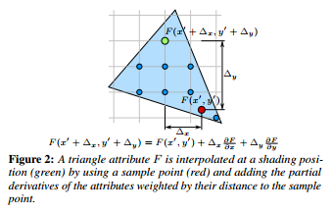
Visibility Buffer – Shading pseudocode
Shading position is green
Sample point is red
Interpolate vertex attributes at pixelpos using triangle gradient == add partial derivatives of the attributes weighted by distance to sample point

